Slide 1

Introduction to Research Data Management
30th November 2016
Friends House, London Euston
Jonathan Rans
Digital Curation Centre
This work is licensed under the Creative Commons Attribution 2.5 UK: Scotland License.

Slide 2
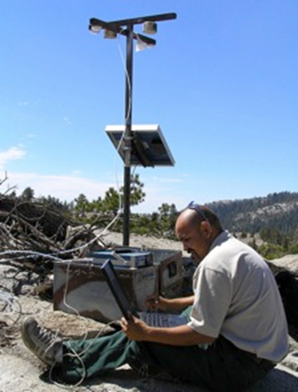
Why is RDM an issue?
Digital technology now used very widely in research, and is enabling new research and scientific paradigms
Research funders and publishers know that digital research data can be expensive to produce but inexpensive to share, making reuse more feasible and desirable
The challenge is to ensure digital research findings can be reproduced and cited
Notes:
There is a recognition that preservation skills which we have developed over hundreds of years are not sufficient to ensure the longevity of digital research material, which increasingly comprises the majority of the research record.

Slide 3



Definitions of research data?
“Research data, unlike other types of information is collected, observed, or created, for purposes of analysis to produce original research results.”
“Research data is defined as recorded factual material commonly retained by and accepted in the scientific community as necessary to validate research findings; although the majority of such data is created in digital format, all research data is included irrespective of the format in which it is created.“
“Evidence which is used or created to generate new knowledge and interpretations. ‘Evidence’ may be intersubjective or subjective; physical or emotional; persistent or ephemeral; personal or public; explicit or tacit; and is consciously or unconsciously referenced by the researcher at some point during the course of their research.”

Slide 4
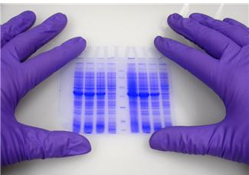

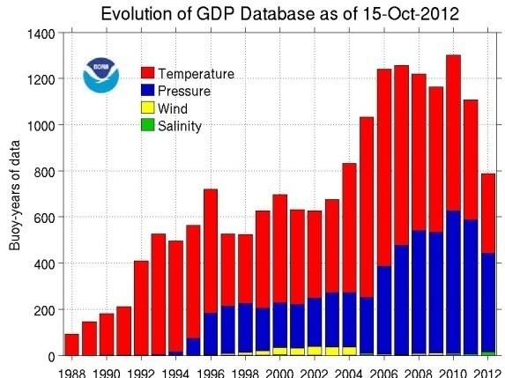


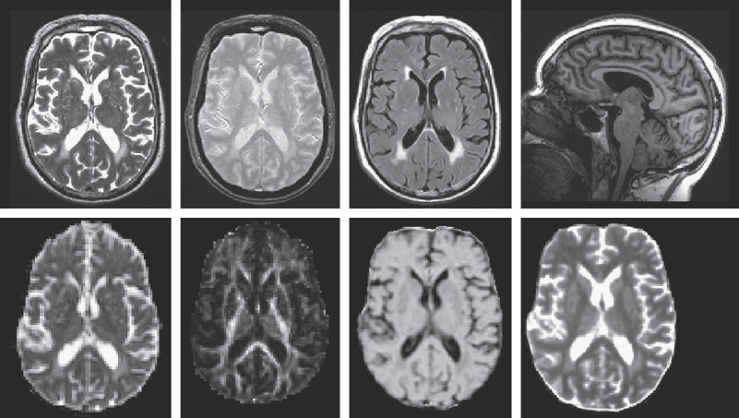

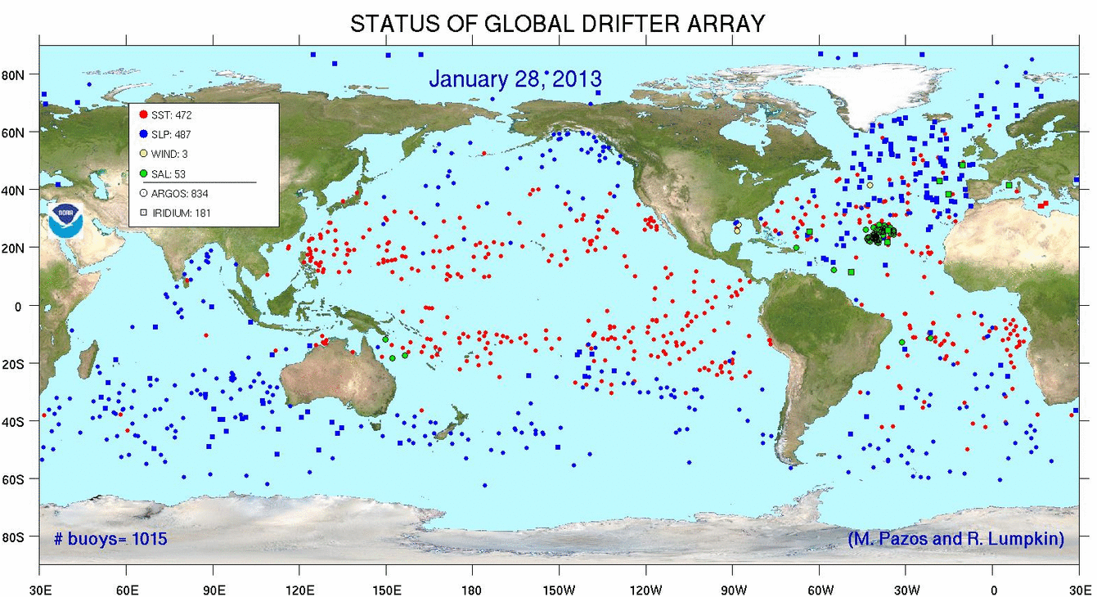
So, what might this include?
http://www.aoml.noaa.gov/phod/dac/array_growth.html
http://www.sbirc.ed.ac.uk/documents/lbc_protocol.pdf
Anything & everything produced in the course of research
http://www.aoml.noaa.gov/phod/graphics/dacdata/globpop.gif
Notes:
Instrument measurements
Experimental observations
Still images, video and audio
Text documents, spreadsheets, databases
Quantitative data (e.g. survey data)
Survey results & interview transcripts
Simulation data, models & software
Slides, artefacts, specimens, samples
Questionnaires
Sketches, diaries, lab notebooks …

Slide 5
What is research data management?
Plan
Create
Use
Appraise
Deposit and Publish
Discover and Reuse
“an explicit process covering the creation and stewardship of research materials to enable their use for as long as they retain value.”
Data management is part of
good research practice
Notes:
5

Slide 6
Why manage research data?
To make research easier!
To stop yourself drowning in irrelevant stuff
In case you need the data later
To avoid accusations of fraud or bad science
To share data so others can use and learn from it
To get credit for producing the data
Because somebody else said to do so
Notes:
Data is increasing in significance. It will unquestionably matter to your research careers, more than it does to your supervisors’ generation.
Learn good data habits now! You’ll need them later.

Slide 7
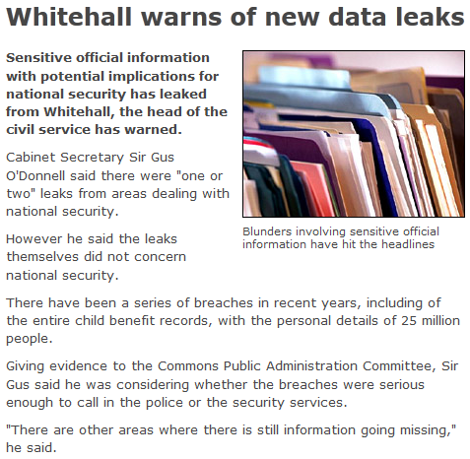
What if data fell into the wrong hands?
http://news.bbc.co.uk/1/hi/uk/8332445.stm

Slide 8
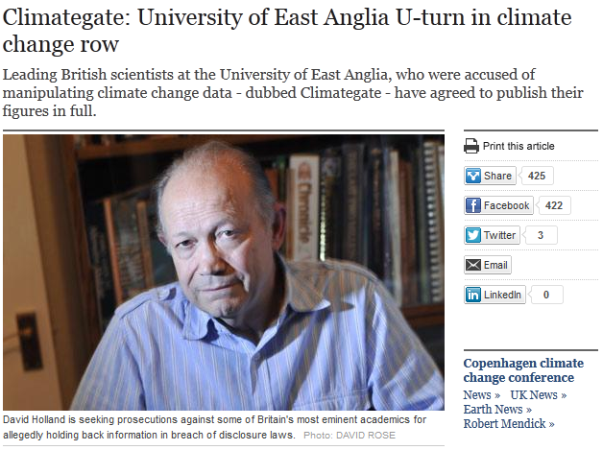
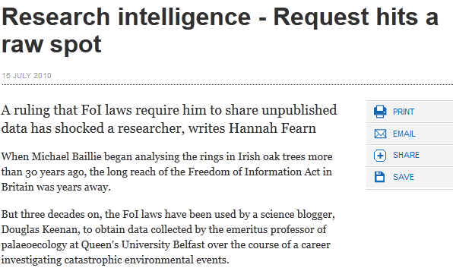


What if you had to produce data?

Slide 9
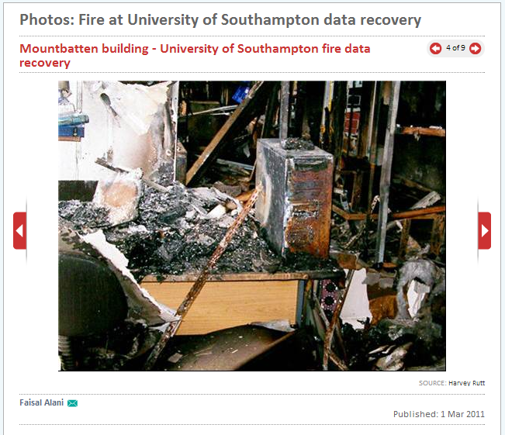
What is the worst-case scenario?
http://www.computerweekly.com

Slide 10

Ultimately funders expect:
Data management plans
timely release of data
  once patents are filed or on (acceptance for) publication
open data sharing
  minimal or no restrictions if possible
preservation of data
  typically 5-10+ years if of long-term value
See the RCUK Common Principles on Data Policy:
www.rcuk.ac.uk/research/Pages/DataPolicy.aspx

Slide 11
What is involved in RDM?
Data Management Planning
Data creation
Annotating / documenting data
Analysis, use, versioning
Storage and backup
Publishing papers and data
Preparing for deposit
Archiving and sharing
Licensing
Citing…
Plan
Create
Use
Appraise
Deposit and Publish
Discover and Reuse

Slide 12
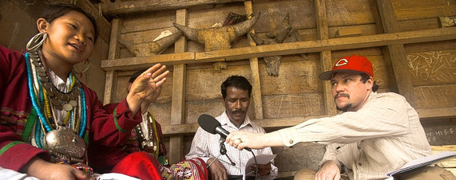
Active data management

Slide 13
Data creation
Adopt file naming conventions:
  http://www.jiscdigitalmedia.ac.uk/guide/choosing-a-file-name/
Design a good project folder structure
  http://research-data-toolkit.herts.ac.uk/document/research-project-file-plan/
Ensure consent forms, licences and partnership agreements don’t restrict opportunities to share data
  http://www.dcc.ac.uk/resources/how-guides/license-research-data
  http://www.data-archive.ac.uk/create-manage/consent-ethics/anonymisation

Slide 14
Some formats are better for long-term
It’s preferable to opt for formats that are:
Uncompressed
Non-proprietary
Open, documented
Standard representation (ASCII, Unicode)
Data centres may have preferred formats for deposit e.g.
Type | Recommended | Non-preferred
Tabular data | CSV, TSV, SPSS portable | Excel
Text | Plain text, HTML, RTF PDF/A only if layout matters | Word
Media | Container: MP4, Ogg Codec: Theora, Dirac, FLAC | Quicktime H264
Images | TIFF, JPEG2000, PNG | GIF, JPG
Structured data | XML, RDF | RDBMS
Further examples: http://www.data-archive.ac.uk/create-manage/format/formats-table
Notes:
Some formats are better for data sharing and long-term preservation than others.
It’s preferable to use formats that are uncompressed (e.g. large, high-quality files like .wav), non-proprietary (i.e. open) standards that are documented and well-understood. This aids preservation and interoperability.
Some data centres have preferred formats for deposit so it’s worthwhile encouraging researchers to consult these to check.

Slide 15
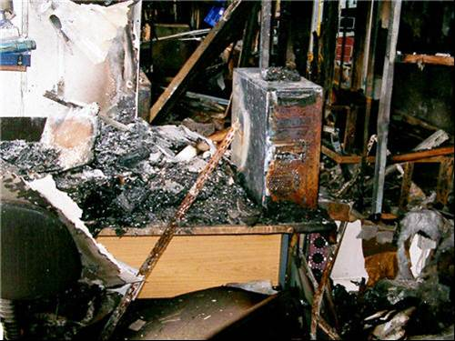
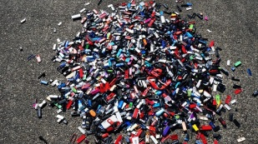
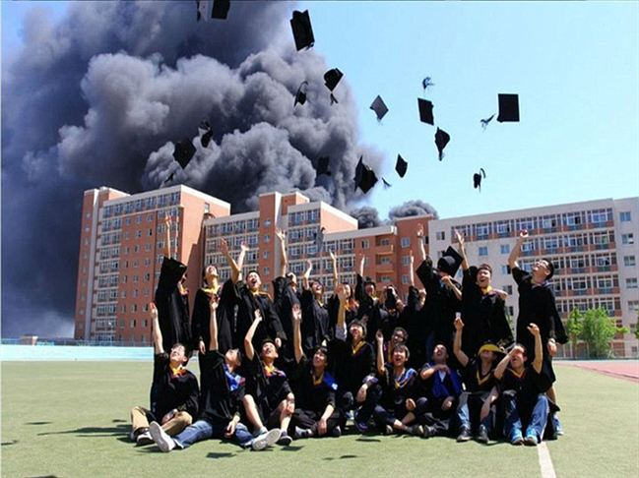
Storage and backup
Use managed services where possible e.g. shared drives rather than local or external hard drives
Consider the security implications of where you store data and how you transfer it
3… 2… 1… backup!
  at least 3 copies of a file
  on at least 2 different media
  with at least 1 offsite

Slide 16
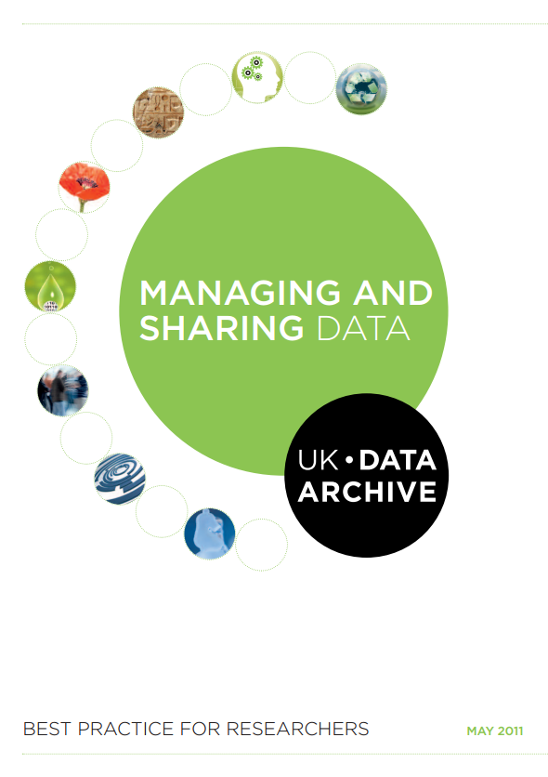
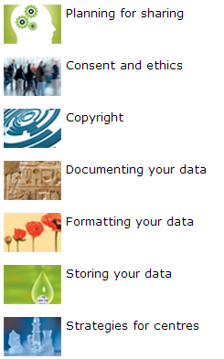
RDM and sharing : a best practice guide
http://data-archive.ac.uk/media/2894/managingsharing.pdf

Slide 17
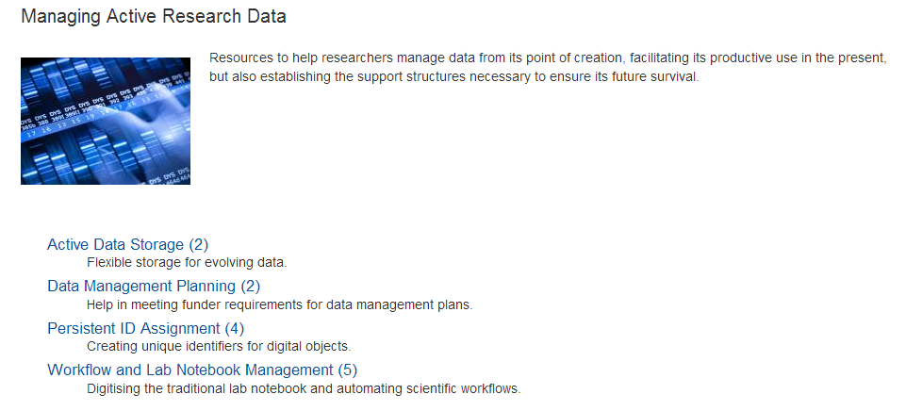


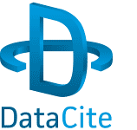


Tools for managing data
www.dcc.ac.uk/resources/external/tools-services/
managing-active-research-data

Slide 18


Any questions?
Jonathan Rans
J.Rans@ed.ac.uk
@JNRans
Image Credits
Harvey Rutt, Southampton. Recovered from: http://www.computerweekly.com
Pile of flash drives: www.flashdrivepros.com
Dalian University fire: www.weirdworldnews.org
Field researcher: http://www.nationalgeographic.com/mission/enduringvoices/expeditions.html

